Slide 1
Sustainability and Environmental Management Systems

Slide 2
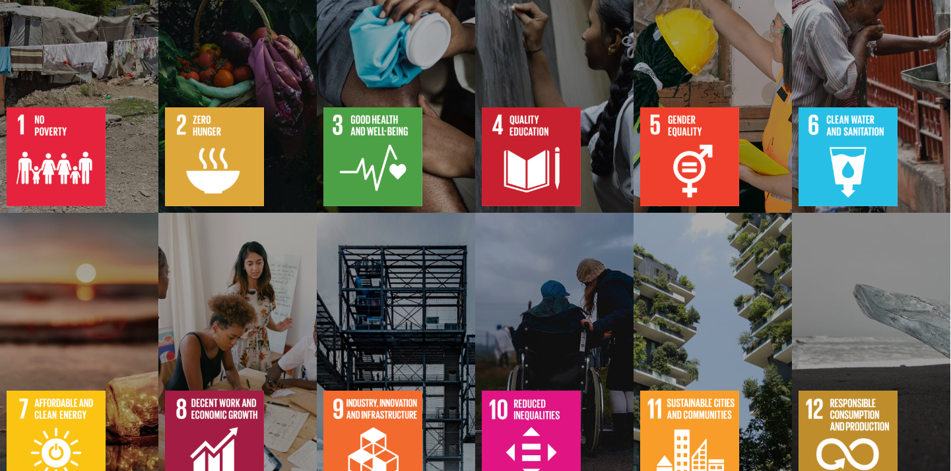
What is Sustainability?
Considerable and intense utilization of natural resources and organizational resources in a judicious and responsible manner.
Developing choices that reflect on the long-term effectiveness and not on short-term outcomes.
Allowing the future generation to benefit positively when the action of the present generation is in question.
Figure: Sustainability in business.
Source: United Nations
Notes:
Sustainability refers to the manner in which we use resources and make decisions today. It does not give organizations an incentive to think about long-term impacts but rather concentrates on such impacts only when the immediate rewards are taken into account. This includes ensuring that this current operation will not give the future generation problems or cause the environment problems.

Slide 3

Main Areas of Sustainability.
Environmental responsibility, such as safeguarding the natural resources and minimization of pollution.
Social responsibility including being fair to employees and giving back to communities.
Economic responsibility, which aims at maintaining profitability in the long run.
Figure: Areas of Sustainability
Source: UN
Notes:
There are three major areas on which sustainability is typically discussed. The former is environmental that comprises environmental protection. The second one is social, which is people and community oriented. The third is the economic, which makes the organization financially stable. The three areas are all interrelated and must be set into balance.

Slide 4
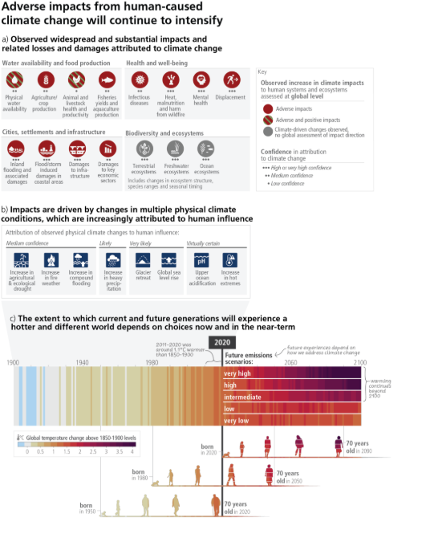
Sustainability in Business Setup.
Less carbon emissions and environmental impact reduction from the operations.
Enhanced use of energy, water, and raw materials in the organization.
Reducing the amount of waste production and eliminating pollution where necessary.
Figure: Carbon effects trends
Source: IPCC (2023)
Notes:
In the case of sustainability in the business context, it gets easier to consider. Organizations involve the need to cut down on emissions, reduce the number of resources, and also decrease waste. Such activities not only contribute to a better environment but also result in efficiency and unnecessary spending reduction.

Slide 5
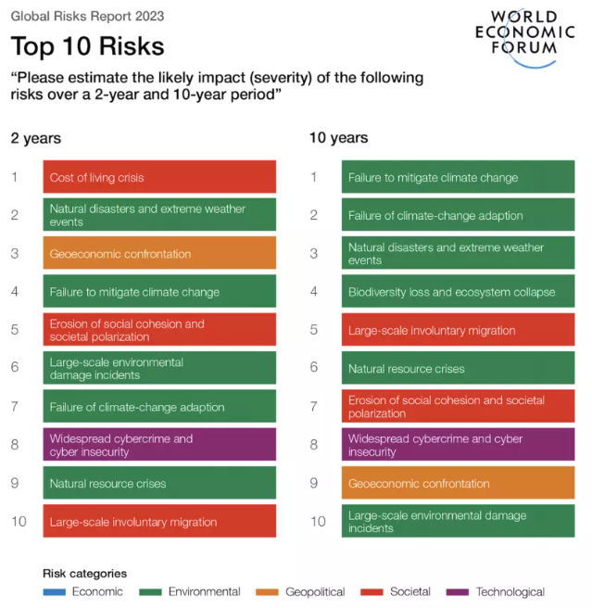
Accountability and Assumptions.
Adhering to the laws and regulations of the industry in order to escape fines.
Responsible management of the supply chains in order to maintain ethical sourcing and production.
Delivering customer, investor, and other stakeholder expectations.
Figure: Sustainable supply chain
Source: World Economic Forum (2023)
Notes:
Organizations are progressively being pressured to act responsibly. Stricter regulations are being enforced, and businesses are called upon to be ethically responsible by the stakeholders. This involves ensuring that suppliers are also responsible.

Slide 6
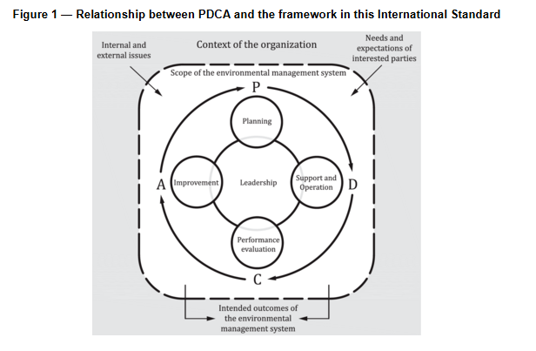
Environmental Management System, what is it?
An organized method that organizations employ in order to deal with the impacts of the environment.
Plans the sustainability-related operations in an organizational manner.
Incorporates environmental considerations in the normal business decisions.
Figure: EMS Structure
Source: ISO 1400
Notes:
An Environmental Management System, or EMS, is a framework used to assist organizations to manage their environmental role. Rather than addressing problems ad hoc, it offers a decent organization in terms of planning, acting on, and upgrading environmental processes.

Slide 7
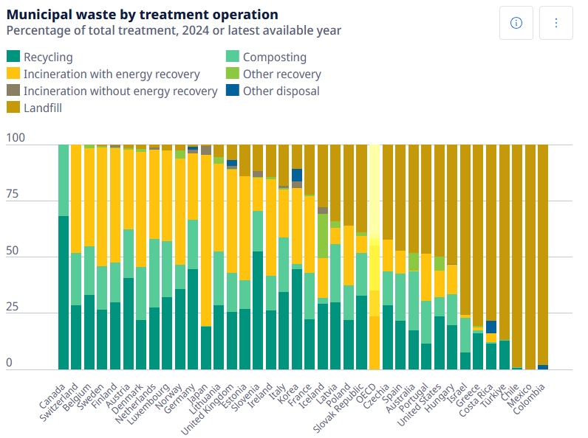
Purpose of an EMS
Assists the organizations in observing the impacts of their operations on the environment.
Enhances productivity by establishing where resources are squandered.
Makes sure that every legal and regulatory requirement is being addressed.
Figure: Environmental Performance graph
Source: OECD (2023)
Notes:
The principal aim of an EMS is to enable organizations to have improved control over their environmental impact. It enables them to monitor performance, enhance efficiency, and ensure that they are adhering to all the applicable laws.

Slide 8
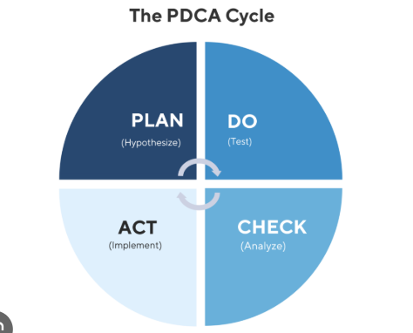
How EMS Works
• Planning phase—identification of environmental impacts and setting of objectives.
• Implementation stage where control and processes are realized.
• Constellation stage where the performance is checked and assessed.
• Improvement stage whereby decisions are made because of the results.
Figure: PDCA Cycle
Source: ISO (2024)
Notes:
EMS is a cyclical process. The organization, first of all, defines its environmental impacts and goals. Thereafter, it implements mechanisms to control those effects. It then evaluates the performance and lastly makes the improvements based on what happens to be learned.

Slide 9
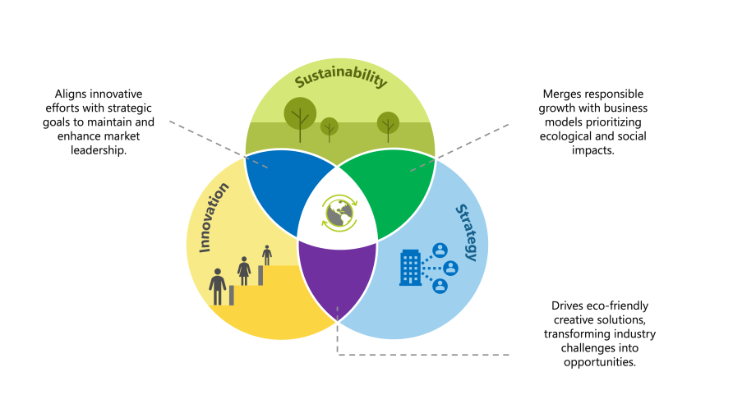
Connection between sustainability and EMS.
Sustainability offers the general meaning and aim of the environmental action.
EMS puts sustainability goals into practice and process.
They are taken together, both to provide long-term thinking and day-to-day management.
Figure: Sustainability, Innovation and Strategy
Source: Prospectus (2024)
Notes:
Sustainability and EMS are the two terms that are intertwined. Sustainability provides a sense of direction by determining the goals the organization desires in the long run. EMS is the provider of the instruments and procedures required to put such goals into practice.

Slide 10
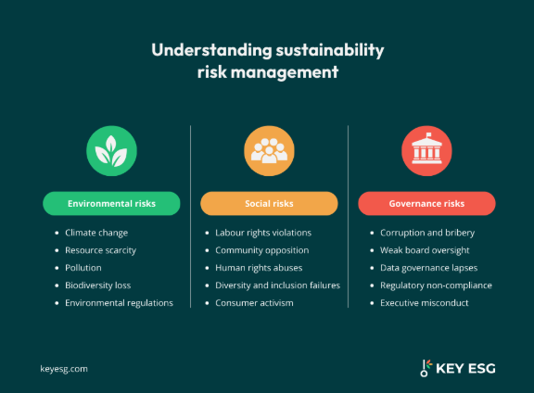
The way sustainability designs EMS.
• Affects environmental policy creation processes in the organization.
• Promotes long-term goal setting rather than short-term solutions.
• Facilitates participation of various stakeholders within the organization.
Risk Management Framework
Source: WEF (2024)
Notes:
Sustainability is important when it comes to designing and implementing EMS. It urges organizations to be proactive, engage various stakeholders, and be concerned about the long-term gains, as opposed to finding short-term solutions.

Slide 11
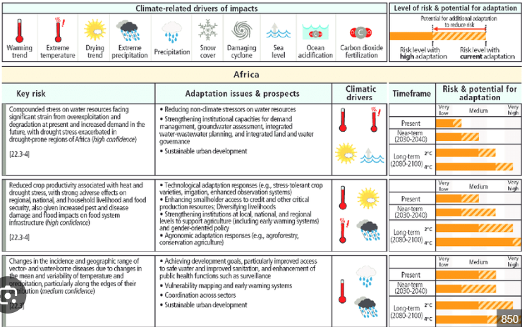
The Need for Sustainability in Organizations.
• Specializing in more environmental regulations that organizations have to abide by.
• The increasing threats posed by climate change that can disrupt operation.
• Low supply of natural resources for long-term growth.
Climate Risk Assessment
Source: IPCC (2023)
Notes:
The importance of sustainability can be explained in a number of ways. Rules are getting tougher, climate change is sourcing out new threats, and resources are getting difficult to reach. Companies that fail to consider these determinants will be at a great risk in years to come.

Slide 12
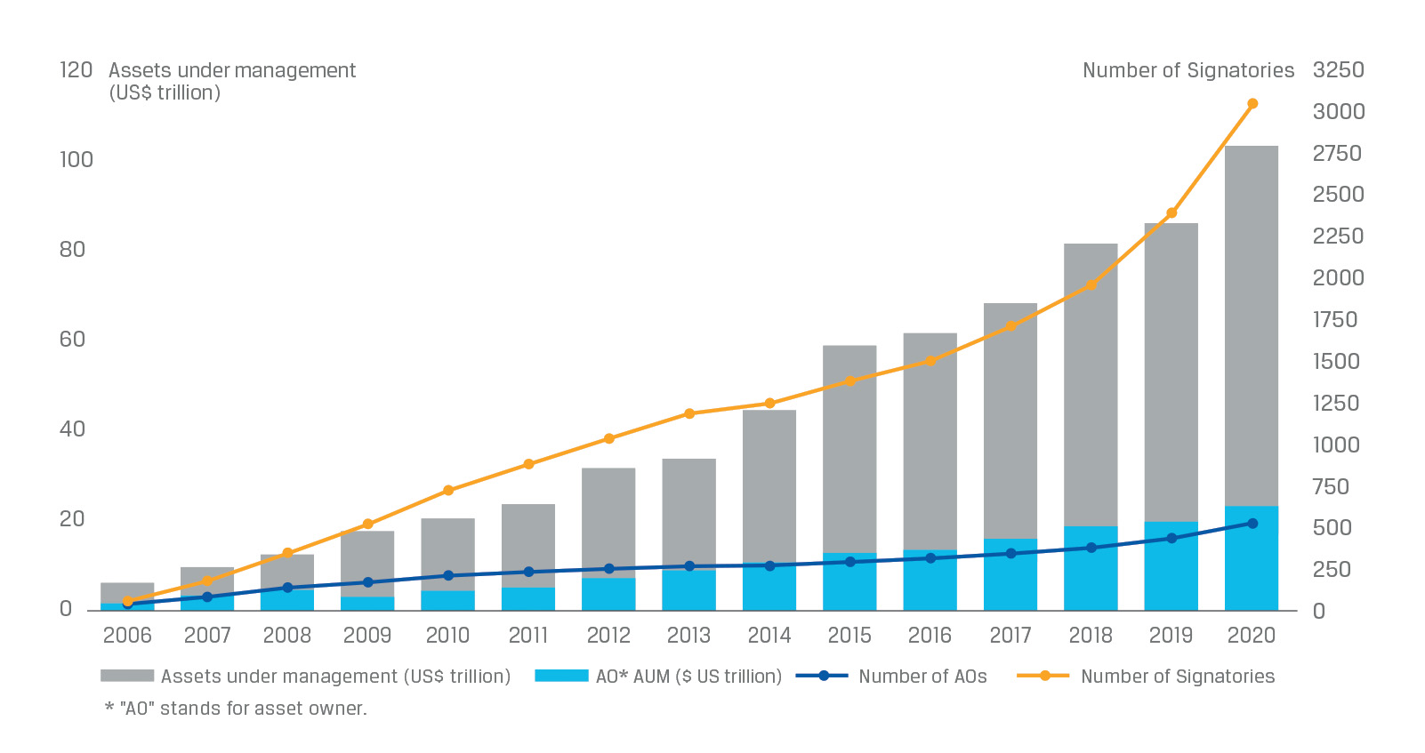
Pressures on Organizations Which are external.
• Investors are increasingly concentrating on responsible business in terms of the environment.
• Customer: Customers like organizations that practice sustainability.
• There is a growing competition with rising implementation of sustainability strategies by more companies.
ESG Growth Chart
Source : PwC (2024)
Notes:
There is also an external pressure. Investors prefer to invest in sustainable companies, and customers are scrutinizing the way businesses are conducted. This implies that organizations are forced to change in order to be competitive.

Slide 13
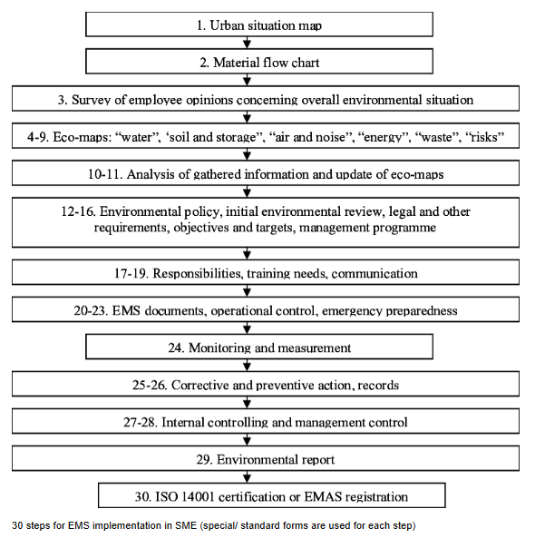
The support of EMS to sustainability.
• Gives good procedures to control environmental responsibilities.
Action: Measures performance in a quantifiable way to monitor the progress.
• Incorporates sustainability into operations and making decisions.
EMS implementation flow
Source: ISO (2024)
Notes:
EMS promotes sustainability because it involves daily operations. It presents transparent procedures and enables organizations to gauge their progress, which can easily be improved as time goes on.

Slide 14
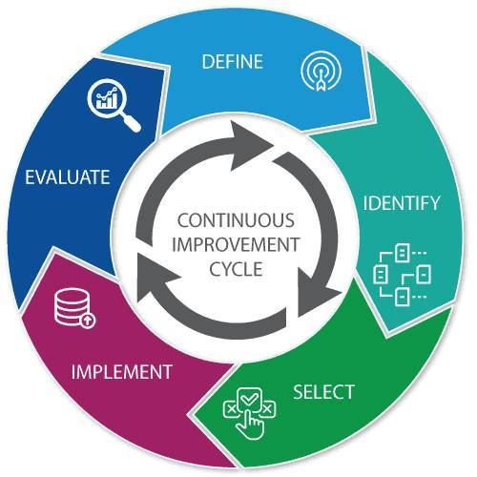
Continuous Improvement.
• Laying down precise and quantifiable environmental targets of the organization.
• On a regular basis, performance should be reviewed to determine areas of weakness.
• Continuing to make changes to better efficiency and less impact according to Deloitte (2023) .
Continuous Improvement Cycle
Source: Deloitte (2023)
Notes:
Continuous improvement is one of the most significant qualities of an EMS. Organizations are also supposed to continue to audit their performance and make changes to enhance efficiency and minimize environmental impact.

Slide 15
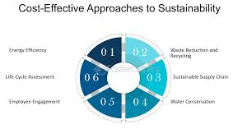
EMS Operational Benefits.
• Cuts back on the operation expenses through efficiency and wasting.
• Enhances better utilization of energy, water, and other resources.
• Reduces environmental accidents and fines.
Cost Saving from Sustainability
Source: OECD (2022)
Notes:
EMS may bring about actual operational advantage. The organizations can reduce costs by enhancing efficiency and minimizing waste. It is also useful in minimizing chances of environmental accidents and penalties.

Slide 16
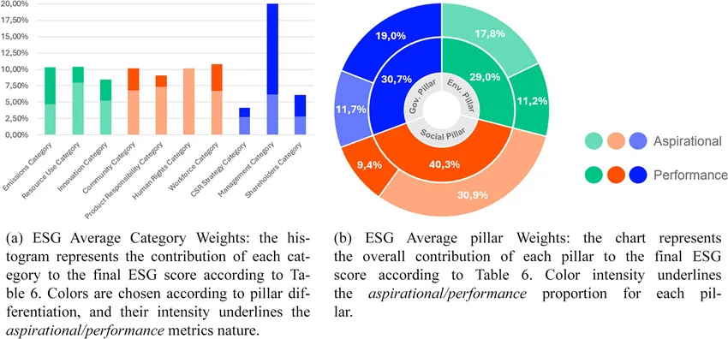
Strategic Advantages to EMS.
• Enhances the reputation and the image of the organization.
• Gains customer trust, investor trust, and regulatory trust.
• Promotes creativity and creation of new opportunities.
ESG Score
Source: Deloitte (2023)
Notes:
Other than business, EMS creates strategic advantages. It enhances the reputation of the organization, develops trust, and at times even develops new business opportunities as a result of innovation.

Slide 17
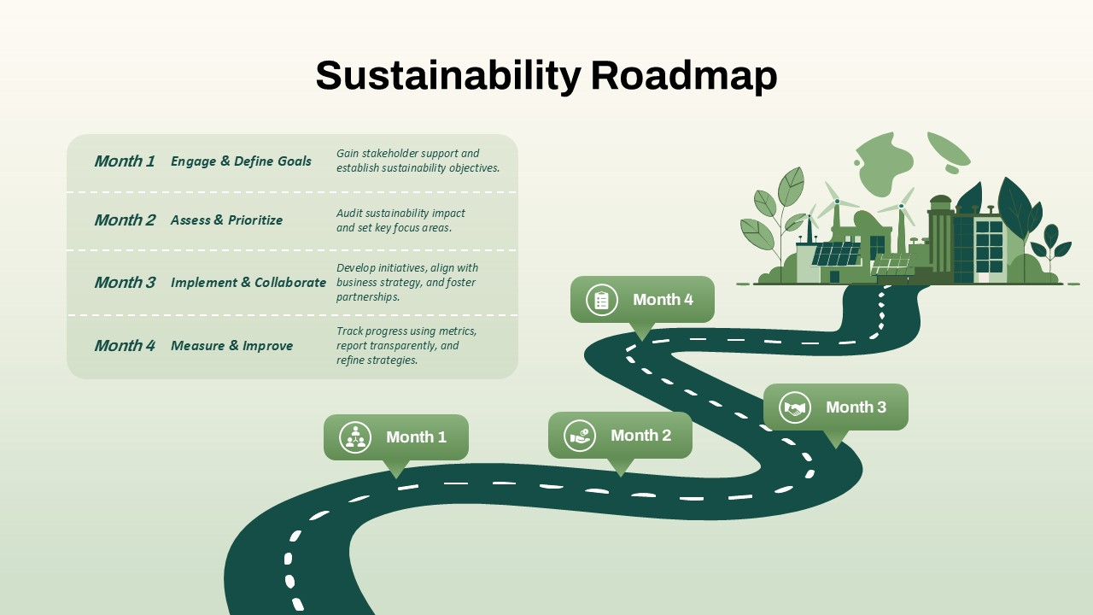
Conclusion
Sustainability is emerging as a key to success on a long-term basis.
EMS is an organization that has a systematic means of attaining sustainability goals.
Early-acting organizations have chances of succeeding in the future.
Sustainability Roadmap
Source: IEA (2023)
Notes:
In conclusion, sustainability is no longer something organizations need not think about. The EMS offers an objective and practical means of handling the environmental obligations. Those organizations that act now will be better placed in the future.

Slide 18
References
Deloitte (2023). The sustainability advantage: Driving long-term business performance. Deloitte Insights.
IEA. Energy Efficiency 2023. IEA
ISO (2024). ISO 14001: Environmental management systems – Requirements with guidance for use. ISO.
United Nations (2023). The sustainable development goals report 2023. United Nations.
PWC (2024). Global ESG investor survey 2024. PwC

